Slide 1
Linear Algebra Essentials for Datascience
Sadiq Pasha
Dataplusplusscience tuitions
Youtube: https://www.youtube.com/@Dataplusplusscience

Slide 2
Topics:
What is a vector? Types and properties
Vector Addition & subtraction
Vector - Scalar Multiplication
Vector - Vector multiplication
Norm of a vector & plotting it
What is a Matrix & Computing Dot product of 2 matrices & plotting
Testing dot product as commutative
Vector Hadamard multiplication, Vector Outer product & Vector Cross product
Vectors with complex numbers
Hermitian Transpose or Conjugate transpose
Span of a vector
Matrix and Types & plotting
Matrix Addition & Subtraction
Matrix Scalar multiplication
Matrix Diagonal Trace
Matrix Matrix multiplication
Matrix order of Operations
Matrix vector multiplication
2D transformation matrix
Additive Multiplicative identity matrices
Hadamard multiplication of matrices
Frobenius dot product
Matrix Rank
matrixSpace
Solving Equations
Matrix determinant
Inverse of a Matrix
Projection_orthogonalization
LeastSquares
Eigen vectors
Singular Value Decomposition
QuadForm Definite
matrixSpaces

Slide 3
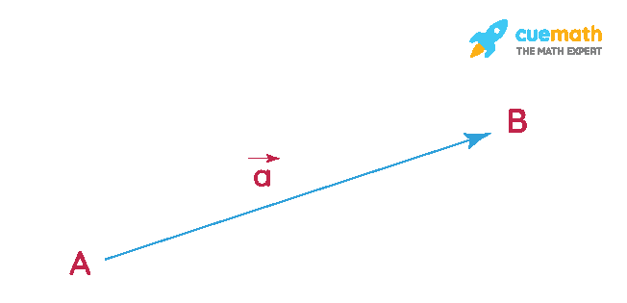
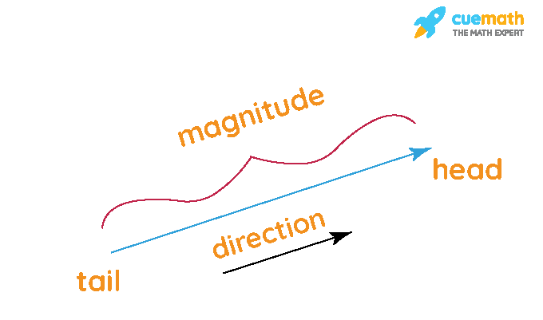
Vectors
Vectors in math is a geometric entity that has both magnitude and direction
Vector AB can be denoted as −−→ABAB→. The standard form of representation of a vector is →A=a^i+b^j+c^kA→=ai^+bj^+ck^. Here, a,b,c are real numbers and ^i,^j,^ki^,j^,k^ are the unit vectors along the x-axis, y-axis, and z-axis respectively.
The magnitude of a vector can be calculated by taking the square root of the sum of the squares of its components. If (x,y,z) are the components of a vector A, then the magnitude formula of A is given by,|A| = √ (x2+y2+z2)
The magnitude of a vector is a scalar value.
Angle between 2 vectors a and b is given by:
θ = cos-1[(a·b)/|a||b|]

Slide 4
Types of Vectors
Zero Vectors
Vectors that have 0 magnitude are called zero vectors, denoted by →00→ = (0,0,0). The zero vector has zero magnitudes and no direction. It is also called the additive identity of vectors.
Unit Vectors
Vectors that have magnitude equals to 1 are called unit vectors, denoted by ^aa^. It is also called the multiplicative identity of vectors. The magnitude of a unit vectors is 1.
Position Vectors
Position vectors are used to determine the position and direction of movement of the vectors in a three-dimensional space. The magnitude and direction of position vectors can be changed relative to other bodies. It is also called the location vector.

Slide 5
Types of Vectors
Equal Vectors
Two or more vectors are said to be equal if their corresponding components are equal. Equal vectors have the same magnitude as well as direction. They may have different initial and terminal points
Negative Vector
A vector is said to be the negative of another vector if they have the same magnitudes but opposite directions
Parallel Vectors and Anti-parallel vectors
Two or more vectors are said to be parallel vectors if they have the same direction but not necessarily the same magnitude. The angles of the direction of parallel vectors differ by zero degrees. The vectors whose angle of direction differs by 180 degrees are called antiparallel vectors, that is, antiparallel vectors have opposite directions.

Slide 6
Types of Vectors
Orthogonal Vectors
Two or more vectors in space are said to be orthogonal if the angle between them is 90 degrees. In other words, the dot product of orthogonal vectors is always 0. a·b = |a|·|b|cos90° = 0.
Co-initial Vectors
Vectors that have the same initial point are called co-initial vectors.

Slide 7
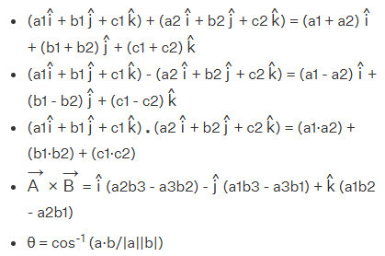
Vector Formulas
Addition of vectors is a vector with magnitudes added
Subtraction of vectors is a vector with magnitudes subtracted
Multiplication of vectors is a matrix with only respective magnitudes multiplied and added.
Cross product of a matrix is multiplication of difference of corresponding components
Angle between vectors is cos.inv of dot product of vectors over magnitude of vectors

Slide 8
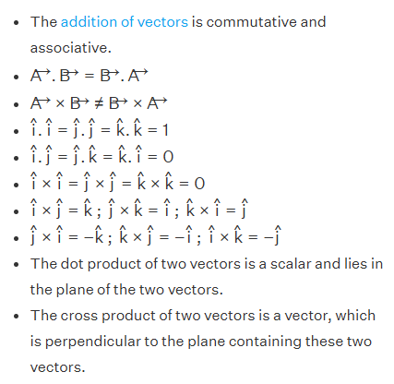
Properties of Vectors

Slide 9
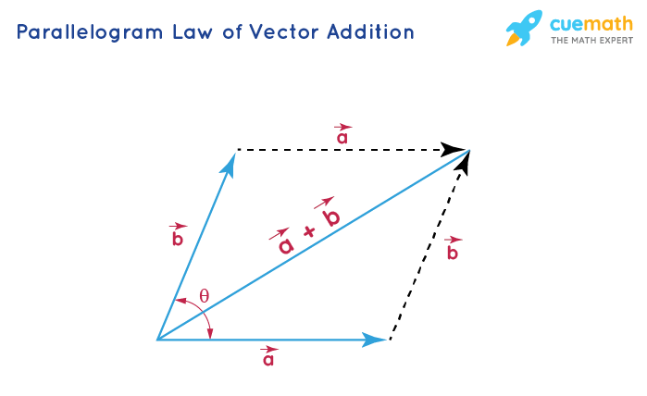
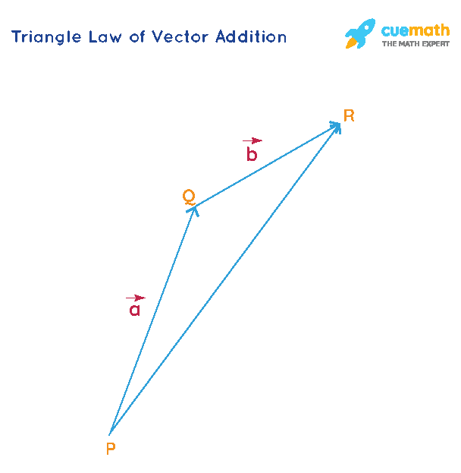
Addition of Vectors
The addition of vectors is commutative and associative. There are two laws of vector addition:
Triangle Law of Addition of Vectors: The law states that if two sides of a triangle represent the two vectors (both in magnitude and direction) acting simultaneously on a body in the same order, then the third side of the triangle represents the resultant vector.
Parallelogram Law of Addition of Vectors: The law states that if two co-initial vectors acting simultaneously are represented by the two adjacent sides of a parallelogram, then the diagonal of the parallelogram represents the sum of the two vectors, that is, the resultant vector starting from the same initial point.

Slide 10
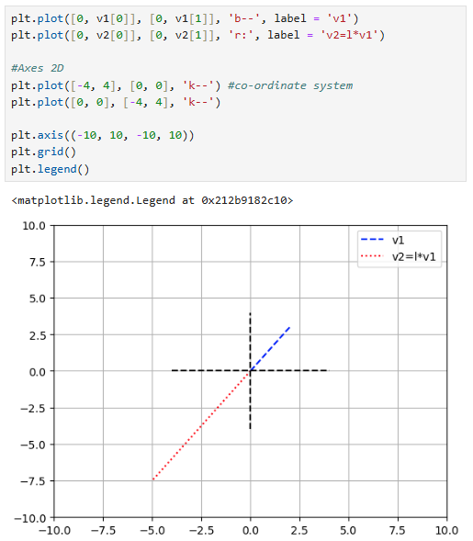
Scalar multiplication of Vectors
A scalar is a real number that has no direction. When a scalar is multiplied by a vector, we multiply the scalar by each component of the vector. The operation of multiplying a vector by a scalar is called scalar multiplication.
Mathematically if scalar is multiplied to vector, then magnitude of vector increases by factor of scalar.
Let v1 = np.array([2, 3])
Then if m = -2.5 be scalar value
>> v2 = m*v1
>> array([-5., -7.5])
As clearly, evident a vector gets stretched in same direction as before if a positive scalar is multiplied and gets stretched in opposite direction if negative scalar is multiplied

Slide 11
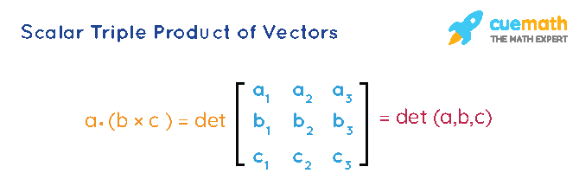
Scalar multiplication of Vectors
Scalar triple product of vectors is the dot of one vector with the cross product of the other two vectors. If any two vectors in a scalar triple product are equal, then the scalar triple product is zero. If the scalar triple product is equal to zero, then the three vectors a, b, and c are said to be coplanar.
Also, a·(b × c) = b·(c × a) = c·(a × b)

Slide 12
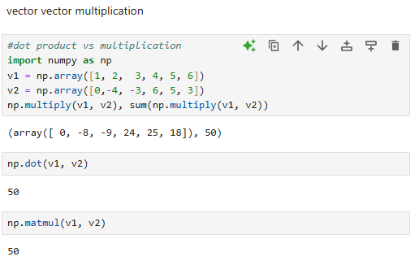
Multiplication of Vectors
There are two different ways to multiply vectors:
Dot Product of Vectors:
The individual components of the two vectors to be multiplied are multiplied and the result is added to get the dot product of two vectors. a·b = (a1 i^ + b1 j^ + c1 k^) ·(a2 i^ + b2 j^ + c2 k^)
= (a1, b1, c1)·(a2, b2, c2)
= (a1·a2) + (b1·b2) + (c1·c2) Another way to determine the dot product of two vectors A and B is to determine the product of the magnitudes of the two vectors and the cosine of the angle between them. A→·B→ = |A||B| cosθ
The resultant of a dot product of two vectors is a scalar value, that is, it has no direction.

Slide 13
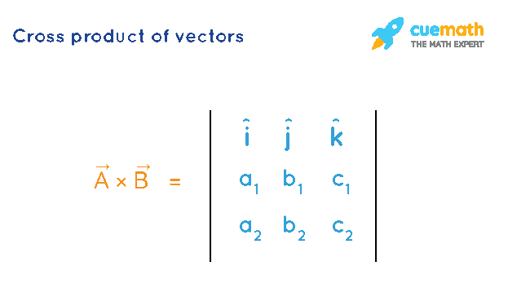
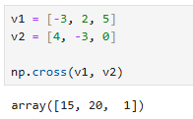
Multiplication of Vectors
Cross Product of vectors:
The vector components are represented in a matrix and a determinant of the matrix represents the result of the cross product of the vectors.
A×→BA→×B→ = (b1c2 - c1b2, a1c2 - c1a2, a1b2 - b1a2) Another way to determine the cross product of two vectors A and B is to determine the product of the magnitudes of the two vectors and the sine of the angle between them. →A×→BA→×B→ = |A||B| sinθ ^n

Slide 14
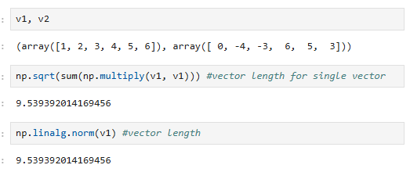
Norm of Vector
Norm of a vector can be defined as the square root of the inner product of a vector with itself.
The vector norm (often simply called "the norm" of a vector v(1, 2, 3), or sometimes the magnitude of a vector) is the L2-norm, given by
|x| = sqrt(1*1+2*2+3*3) = sqrt(14) = 3.74
Where as L1 norm is simply (1+2+3) = 6

Slide 15
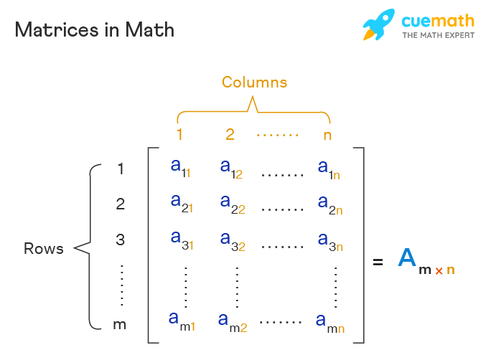
Matrix
A matrix is a rectangular array of numbers, variables, symbols, or expressions that are defined for the operations like subtraction, addition, and multiplications.
The size of a matrix (which is known as the order of the matrix) is determined by the number of rows and columns in the matrix.
The order of a matrix with 6 rows and 4 columns is represented as a 6 × 4

Slide 16
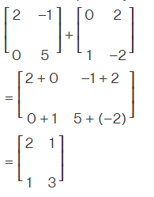
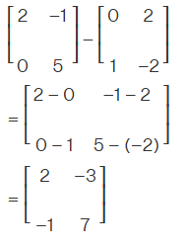
Matrix operations
Addition of Matrices
The addition of matrices can only be possible if the number of rows and columns of both the matrices are the same. While adding 2 matrices, we add the corresponding elements.
i.e., (A + B) = [aij] + [bij] = [aij + bij], where i and j are the number of rows and columns respectively
Subtraction of Matrices
Matrices subtraction is also possible only if the number of rows and columns of both the matrices are the same. While subtracting 2 matrices, we subtract the corresponding elements.
i.e., (A - B) = [aij] - [bij] = [aij - bij], where i and j are the row number and

Slide 17
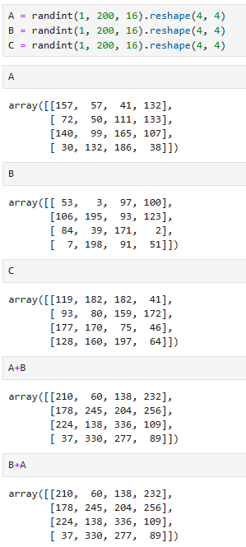
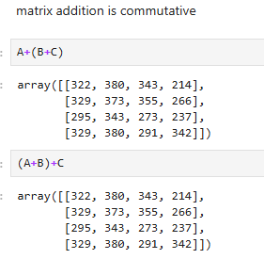
Matrix operations
Addition of matrices is commutative and associative

Slide 18
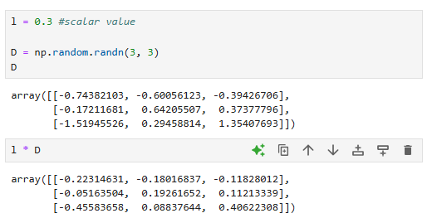
Scalar multiplication
The product of a matrix A with any number 'c' is obtained by multiplying every entry of the matrix A by c, is called scalar multiplication.
i.e., (cA)ij = c(Aij)
Properties of scalar multiplication in matrices
The different properties of matrices for scalar multiplication of any scalars K and l, with matrices A and B are given as,
K(A + B) = KA + KB
(K + l)A = KA + lA
(Kl)A = K(lA) = l(KA)
(-K)A = -(KA) = K(-A)
1·A = A
(-1)A = -A

Slide 19
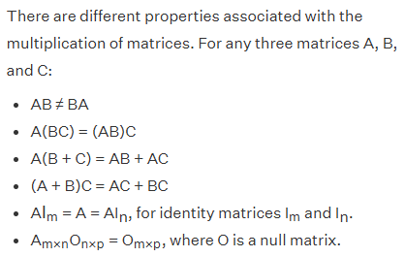
Properties of Matrix Multiplication

Slide 20
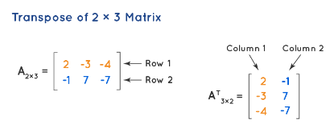

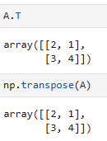
Transpose of a Matrix
The transpose of a matrix is done when we replace the rows of a matrix to the columns and columns to the rows
Properties of transposition in matrices
There are various properties associated with transposition. For matrices A and B, given as,
(A^{T})^{T} = A
(A + B)^{T} = A^{T} + B^{T}, A and B being of the same order.
(KA)^{T}= KA^{T}, K is any scalar(real or complex).
(AB)^{T}= B^{T}A^{T}, A and B being conformable for the product AB. (This is also called reversal law.)

Slide 21
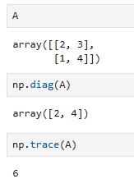
Trace of a Matrix
The trace of any matrix A, Tr(A) is defined as the sum of its diagonal elements. Some properties of trace of matrices are,
tr(AB) = tr(BA)
tr(A) = tr(A^{T})
tr(cA) = c tr(A), for a scalar 'c'
tr(A + B) = tr(A) + tr(B)

Slide 22
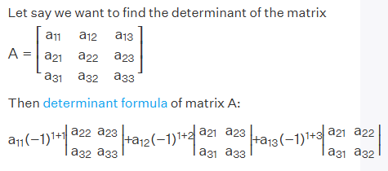
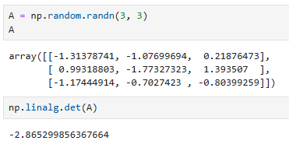
Determinant of a Matrix
The determinant of a matrix is a number defined only for square matrices. It is used in the analysis of linear equations and their solution.
Determinant of a matrix is equal to the summation of the product of the elements of a particular row or column with their respective cofactors. Determinant of a matrix A is denoted as |A|.

Slide 23
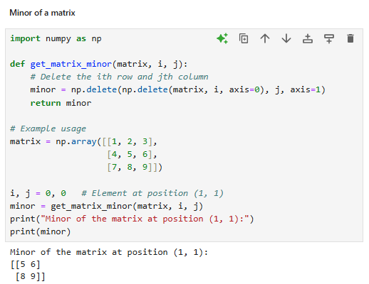
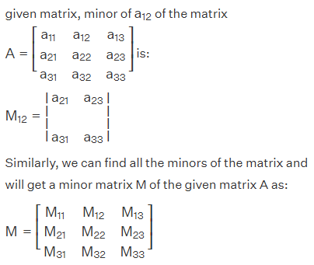
Minor of a Matrix
Minor for a particular element in the matrices is defined as the determinant of the matrix that is obtained when the row and column of the matrix in which that particular element lies are deleted, and the minor of the element aij is denoted as Mij.

Slide 24
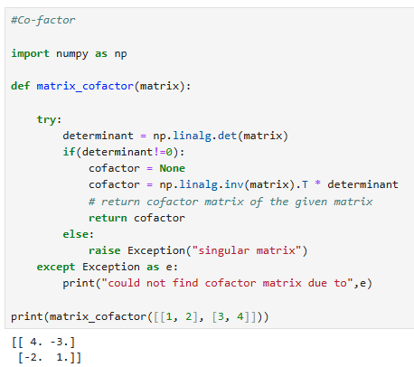
Cofactor of a Matrix
Cofactor of an element in the matrix A is obtained when the minor Mij of the matrix is multiplied with (-1)^{i+j}.
The cofactor of a matrix is denoted as Cij.
If the minor of a matrix is Mij, then the cofactor of the matrix would be:
Cij=(−1)i+j Mij
On finding all the cofactors of the matrix, we will get a cofactor matrix C of the given matrix A:
C= ⎡C11 C12 C13⎤
⎢C21 C22 C23⎥
⎣C31 C32 C33⎦

Slide 25
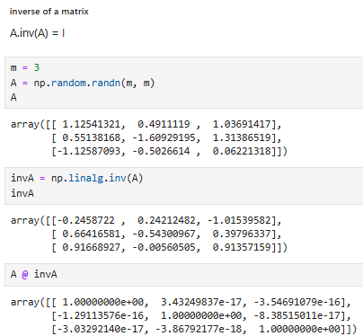
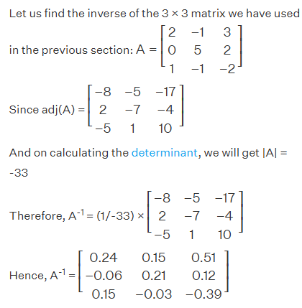
Inverse of a Matrix
The inverse of any matrix is denoted as the matrix raised to the power (-1), i.e. for any matrix "A", the inverse matrix is denoted as A⁻¹
The inverse of a square matrix, A is A⁻¹ only when: A × A⁻¹ = A⁻¹ × A = I.
There is a possibility that sometimes the inverse of a matrix does not exist if the determinant of the matrix is equal to zero(|A| = 0).
Matrices inverse is calculated by using the following formula:
A⁻¹ = (1/|A|)(Adj A)
where
|A| is the determinant of the matrix A and |A| ≠ 0.
Adj A is the adjoint of the given matrix A.

Slide 26
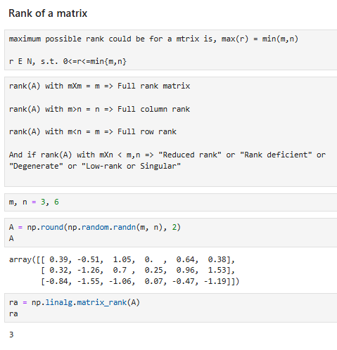
Rank of a Matrix
The rank of a matrix A is defined as the maximum number of linearly independent row(or column) vectors of the matrix.
That means the rank of a matrix will always be less than or equal to the number of its rows or columns.
The rank of a null matrix is zero since it has no independent row or column vectors.

Slide 27
Solving Linear Equations with Matrices
A linear equation in one variable is an equation of degree one and has only one variable term. It is of the form 'ax+b = 0', where 'a' is a non-zero number and 'x' is a variable.
By solving linear equations in one variable, we get only one solution for the given variable. An example for this is 3x - 6 = 0. The variable 'x' has only one solution, which is calculated as 3x - 6 = 0 3x = 6 x = 6/3 x = 2
There are many methods to solve linear equations:
Substitution Method
Elimination Method
Graphical method of Linear equations
Cross Multiplication Method
Cramer’s Rule for solving Linear equation
Gauss-Johnson Elimination Method
Refer:
Solving Linear Equations - 4 Methods, Step-by-Step Solutions, Examples (cuemath.com)
https://www.symbolab.com/solver/linear-equation-calculator/-x%20%2B%203y%20%3D7%20and%20%203x%2B2y%3D1?or=input
https://matrix.reshish.com/gaussSolution.php

Slide 28
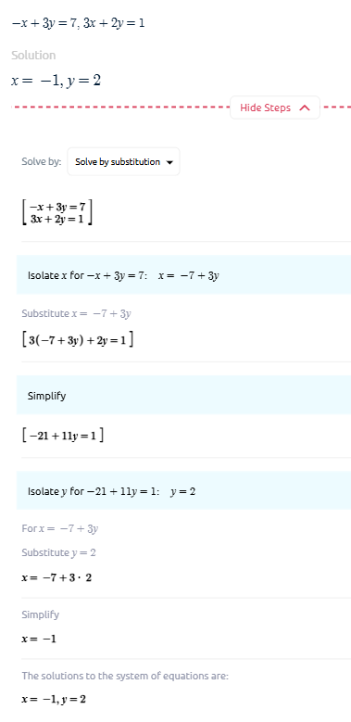
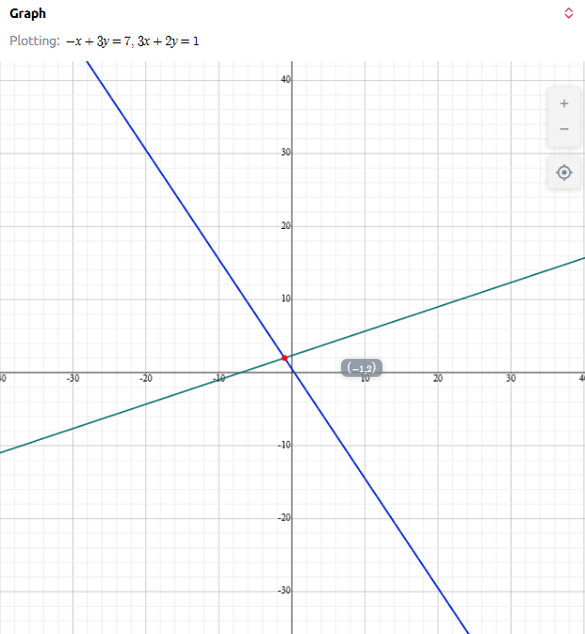
Substitution Method

Slide 29
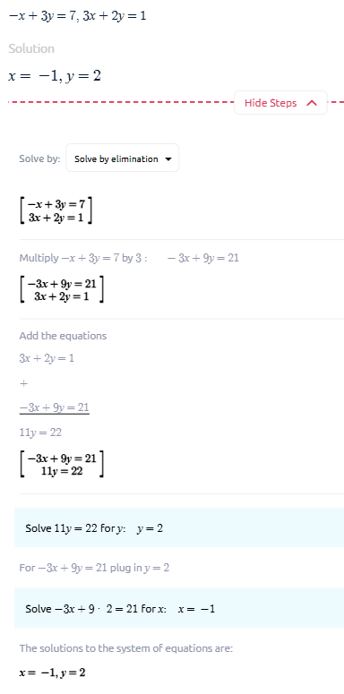
Elimination Method

Slide 30
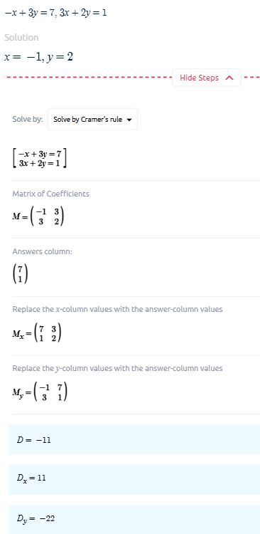
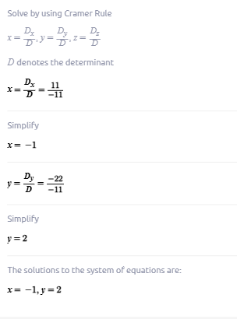
Cramer’s Method
Cramer's rule formula to solve the system AX = B (or) to find the values of the variables x₁, x₂, x₃, ..., xₙ. To solve the system of equations:
Find det |A| and represent it by D.
Find the determinants Dₓ₁, Dₓ₂, Dₓ₃, ..., Dₓₙ, where Dₓᵢ is the determinant of matrix A where the i^{th} column is replaced by the column matrix B.
We divide each of these determinants by D to find the value of the corresponding variables. i.e., x₁ = Dₓ₁/D, x₂ = Dₓ₂/D, ...., xₙ = Dₓₙ/D.

Slide 31
Cramer’s Method
Cramer's rule formula to solve the system AX = B (or) to find the values of the variables x₁, x₂, x₃, ..., xₙ. To solve the system of equations:
Find det |A| and represent it by D.
Find the determinants Dₓ₁, Dₓ₂, Dₓ₃, ..., Dₓₙ, where Dₓᵢ is the determinant of matrix A where the i^{th} column is replaced by the column matrix B.
We divide each of these determinants by D to find the value of the corresponding variables. i.e., x₁ = Dₓ₁/D, x₂ = Dₓ₂/D, ...., xₙ = Dₓₙ/D.

Slide 32
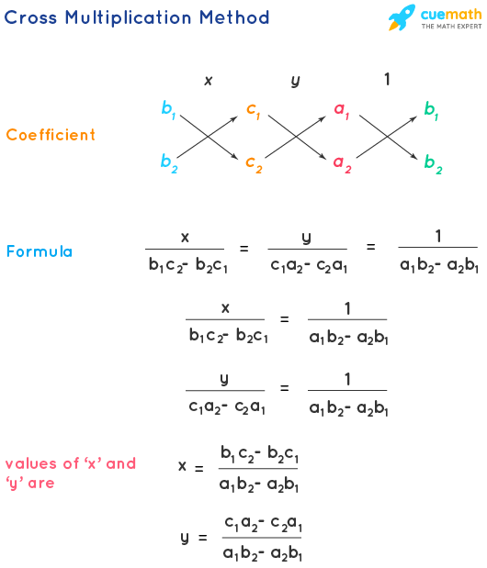
Cross Multiplication Method
The cross multiplication method enables us to solve linear equations by picking the coefficients of all the terms ('x' , 'y' and the constant terms) in the format shown below and apply the formula for finding the values of 'x' and 'y'.

Slide 33
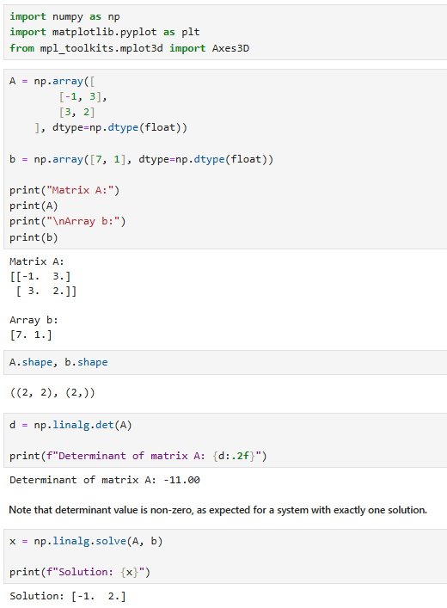
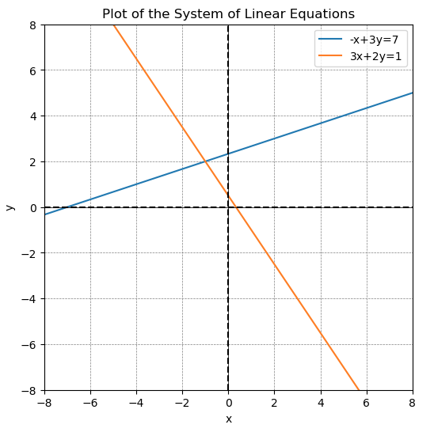
Linear Equations with Unique Solutions
If determinant of two linear equations when represented as a matrix, is non-zero, then they have exactly one solution.
And the linear equations intersect each other at only one unique point

Slide 34
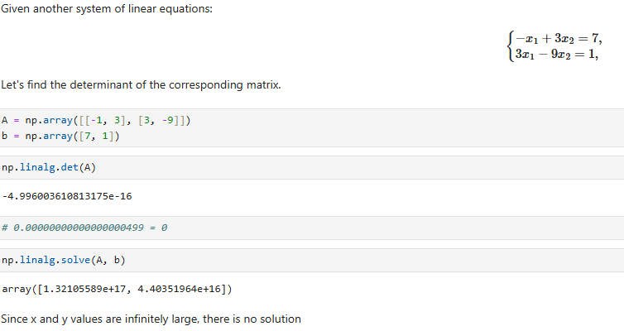
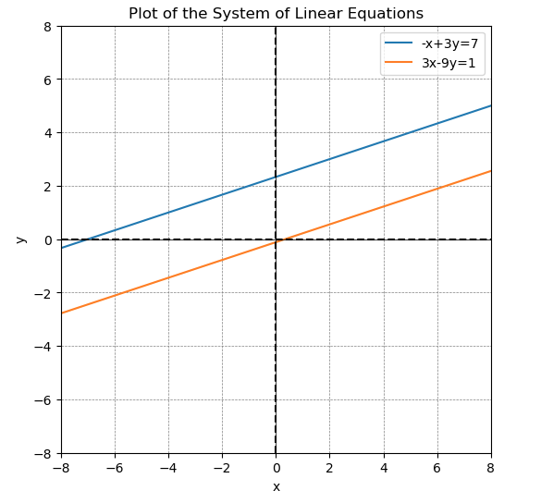
Linear Equations with No Solutions
If determinant of two linear equations when represented as a matrix, is infinitely large, then they have exactly No solution.
And the linear equations are parallel to each other

Slide 35
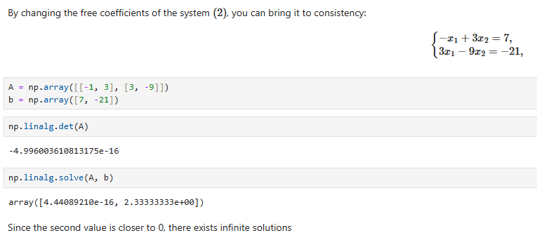
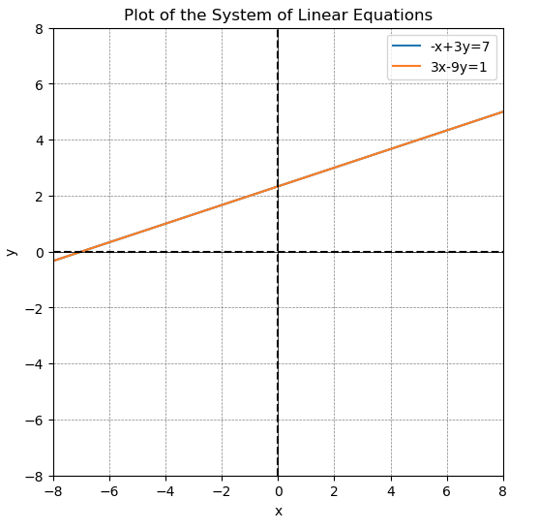
Linear Equations with Infinite Solutions
If determinant of two linear equations when represented as a matrix, is infinitely small or equal to zero. i.e. area formed by equations is zero.
And the linear equations coincide with each other at all points

Slide 36
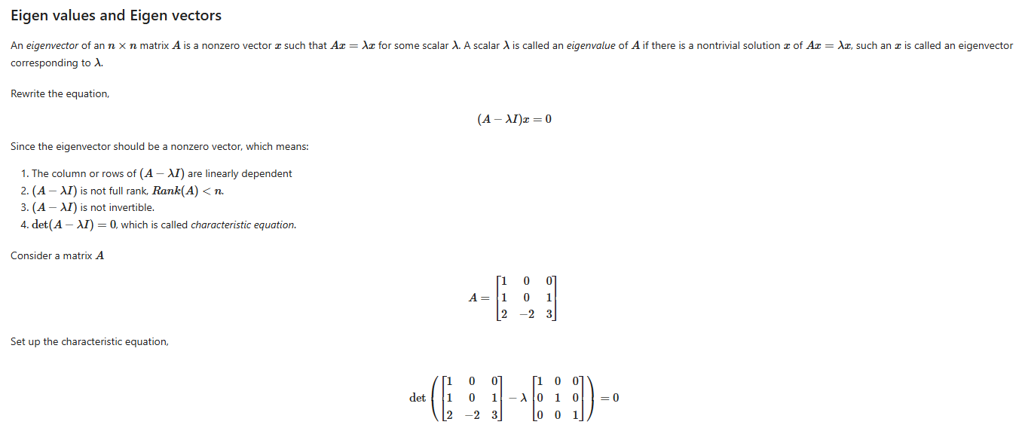
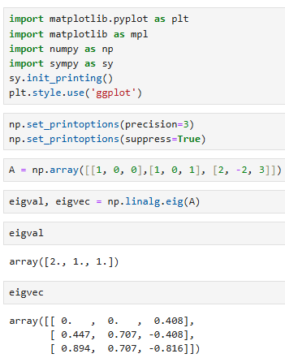
Eigen values and Eigen vectors
The eigenvalues of matrix are scalars by which some vectors (eigenvectors) change when the matrix (transformation) is applied to it.
In other words, if A is a square matrix of order n x n and v is a non-zero column vector of order n x 1 such that Av = λv (it means that the product of A and v is just a scalar multiple of v), then the scalar (real number) λ is called an eigenvalue of the matrix A that corresponds to the eigenvector v.
v (A - λI) = 0
This represents a homogeneous system of linear equations and it has a non-trivial solution only when the determinant of the coefficient matrix is 0.
i.e., |A - λI| = 0
This equation is called the characteristic equation (where |A - λI| is called the characteristic polynomial) and by solving this for λ, we get the eigenvalues.

